Slide 1
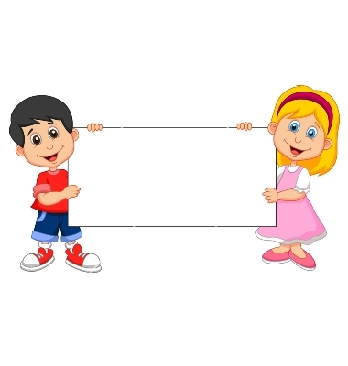
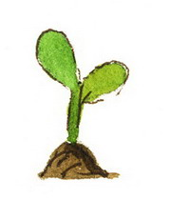
Donation
(Unable Plant)

Slide 2
Girls Version
Familiarization Task

Slide 3
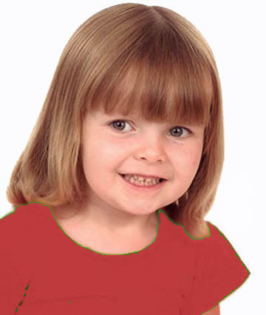
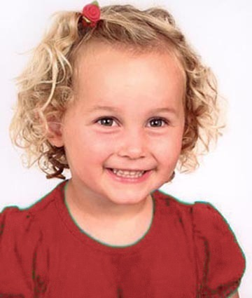
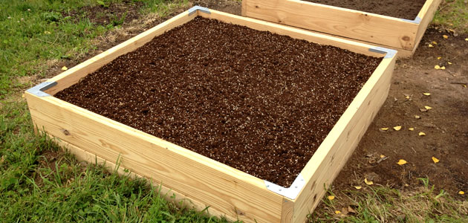
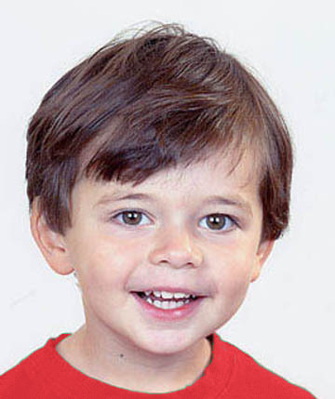
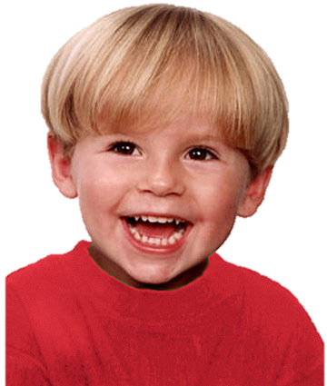
Introduce the group & the garden

Slide 4
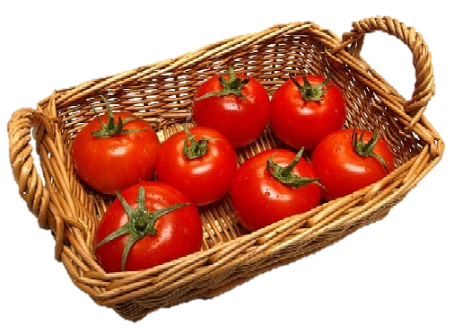
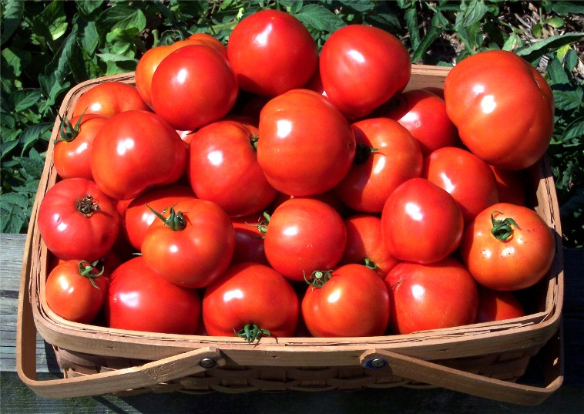
Explain how the garden works

Slide 5
Questions & Feedback

Slide 6
Test Task

Slide 7
The group goal: have a big basket of tomatoes and share them

Slide 8
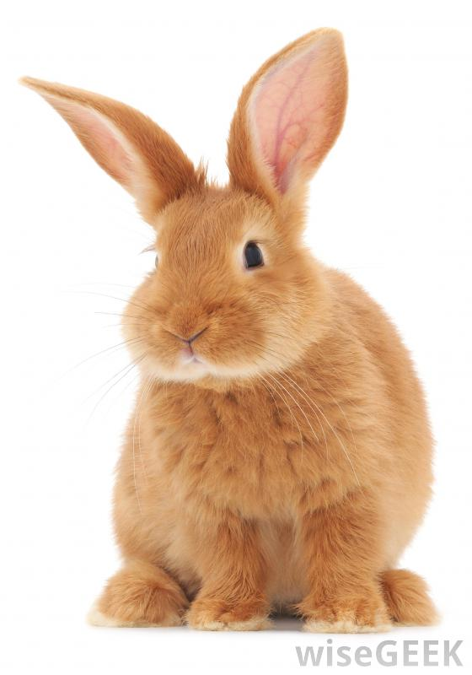
The unable free-rider (upper right):
Wants to put her plant in the garden, but a rabbit comes to eat it

Slide 9
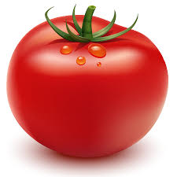
The outcome: They get a small basket of tomatoes. Each kid gets a tomato.

Slide 10
Test Questions
F
C

Slide 11
Contributor Reminder:
Wanted to put her plant in the garden and put it there.

Slide 12

Evaluation: is she good or bad?

Slide 13
Evaluation: a little good/bad or really good/bad?

Slide 14


Preference: Do you like her or you don’t like her?

Slide 15


Preference: do you like her a little or a lot? do you kind of don’t like her or really don’t like her?
To Free-Rider

Slide 16
Unable Free-Rider Reminder:
Wanted to put her plant in the garden but a rabbit ate it.

Slide 17
Evaluation: is she good or bad?

Slide 18
Evaluation: a little good/bad or really good/bad?

Slide 19
Preference: Do you like her or you don’t like her?

Slide 20
Preference: do you like her a little or a lot? do you kind of don’t like her or really don’t like her?
To Contributor

Slide 21

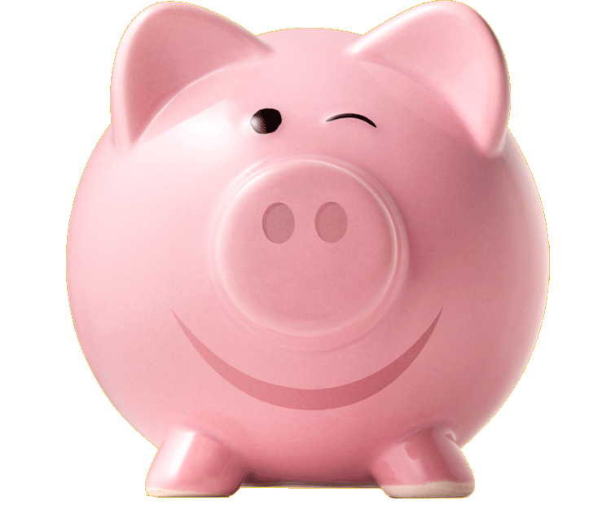
Donation
(Unwilling Piggybank)

Slide 22
Girls Version
Familiarization Task

Slide 23
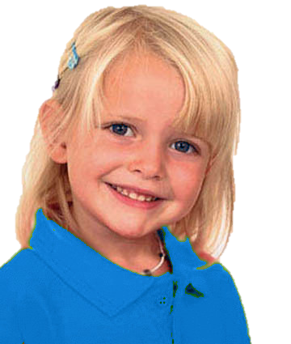
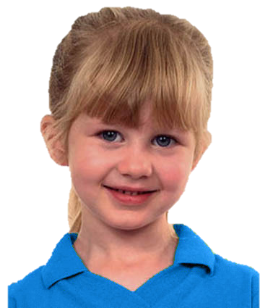
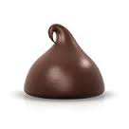
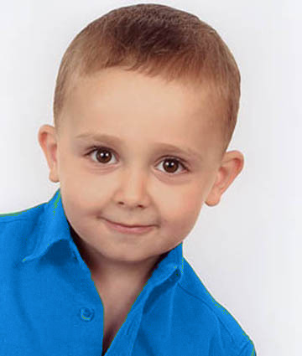
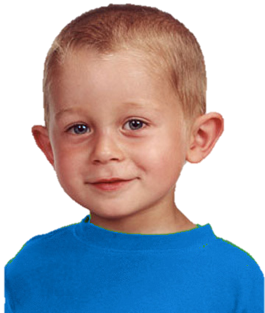
Introduce the group & the piggybank

Slide 24
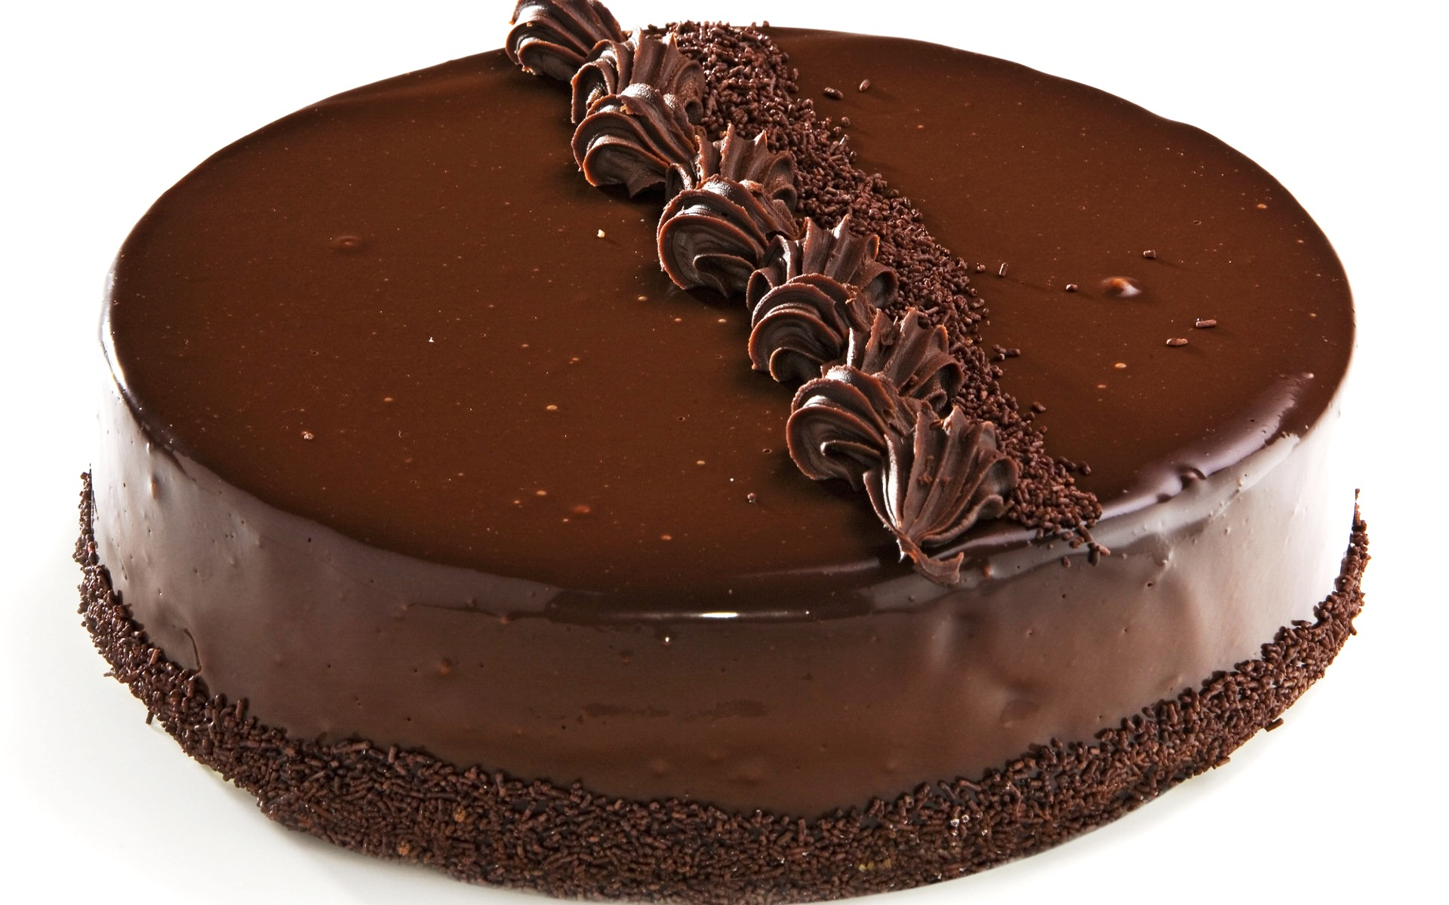
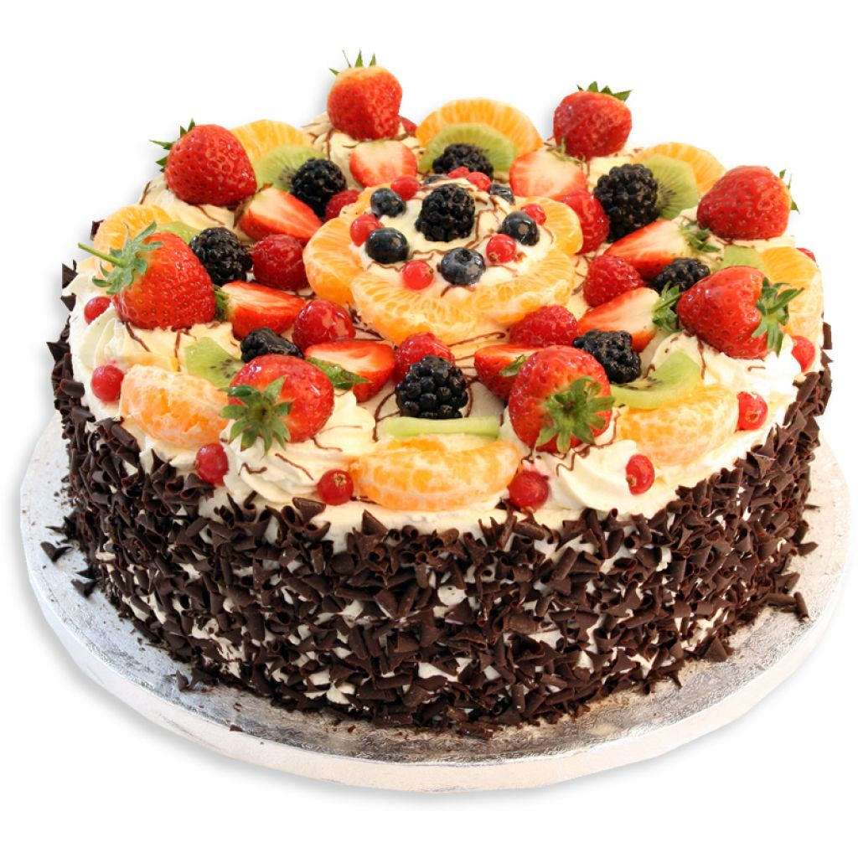
Explain how the piggybank works

Slide 25
Questions & feedback

Slide 26
Test Task

Slide 27
the group goal: have a big cake and share it

Slide 28
Unwilling free-rider (upper left):
Doesn’t want to put her chocolate into the piggybank; she eats it

Slide 29
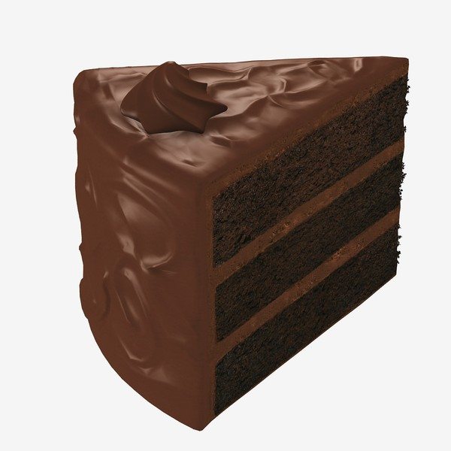
The outcome: The piggy bank makes a small cake. Each kid gets a piece of it.

Slide 30
Test Questions
F
C

Slide 31
Contributor Reminder:
Wanted to put her chocolate into the piggybank and put it there.

Slide 32
Evaluation: is she good or bad?

Slide 33
Evaluation: a little good/bad or really good/bad?

Slide 34
Preference: Do you like her or you don’t like her?

Slide 35
Preference: do you like her a little or a lot? do you kind of don’t like her or really don’t like her?
To Free-Rider

Slide 36
Unwilling Free-Rider Reminder:
Didn’t want to put her chocolate into the piggybank and ate it.

Slide 37
Evaluation: is she good or bad?

Slide 38
Evaluation: a little good/bad or really good/bad?

Slide 39
Preference: Do you like her or you don’t like her?

Slide 40
Preference: do you like her a little or a lot? do you kind of don’t like her or really don’t like her?
To Contributor

